Slide 1
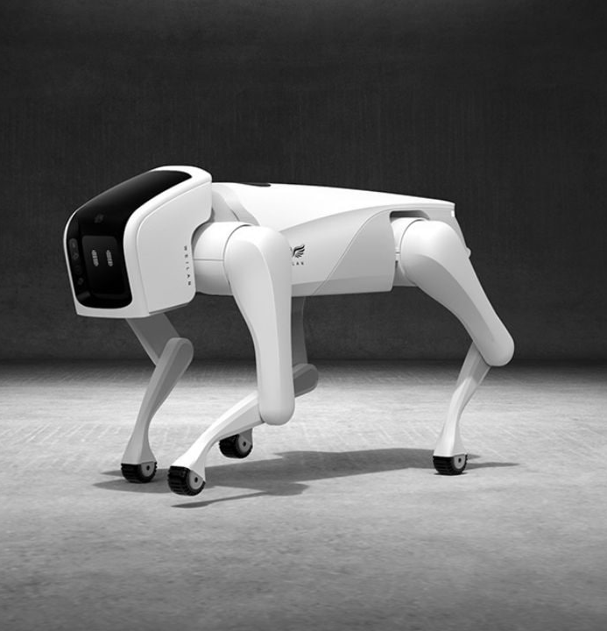
Applikációk
https://chatgpt.com/
https://semiconductor.withgoogle.com/
https://experiments.withgoogle.com/collection/webxr
Are you smarter than ChatGPT?
  https://smarterthangpt.com/?utm_source=futurepedia&utm_medium=marketplace&utm_campaign=futurepedia
https://www.futurepedia.io/?searchTerm=maths

Slide 2

Etika
https://www.youtube.com/watch?v=F4WZ_k0vUDM
https://www.youtube.com/watch?v=JMLsHI8aV0g
https://this-person-does-not-exist.com/en

Slide 3
Oktatást segítő alkalmazások
https://www.eduaide.ai/
https://edpuzzle.com/discover
https://curipod.com/5cbaf15a-d221-4519-8f4b-f6d4cb118e31/lessons/aeccb622-fc0a-4c8a-8560-77cf55a1f70c
https://edugpt.com/
https://www.bing.com/search?q=Bing+AI&showconv=1&FORM=hpcodx
https://app.magicschool.ai/tools

